Slide 1
Information Model extraction & Analysis student-driven
Yi Xiang Tan
Supervisor: Gaye Stephens

Slide 2
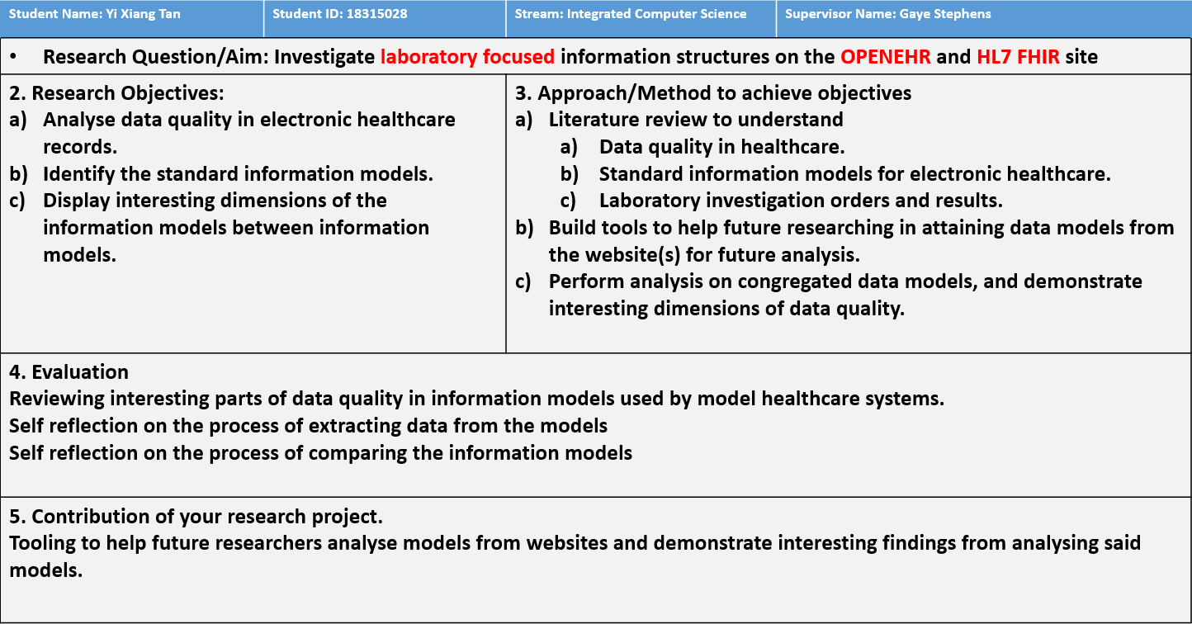

Slide 3
Motivation
People always ask, “what’s the models”, but never “how the models are”
Facilitate future researches
Personal Goals
Different perspective
Only a developer could do

Slide 4
Intermediate challenge
Obtaining models in an easy to process format.
Approach
Look for APIs
Look for available sources
Web scraping

Slide 5
Approach
Look for APIs
Problem
Only OpenEHR provides them
None of the APIs are remotely useful
Rejected

Slide 6
Approach
Look for available sources
Problem
Only OpenEHR provides them via bulk exports
The models exported contains many uninteresting properties, and some interesting properties were not included.

Slide 7
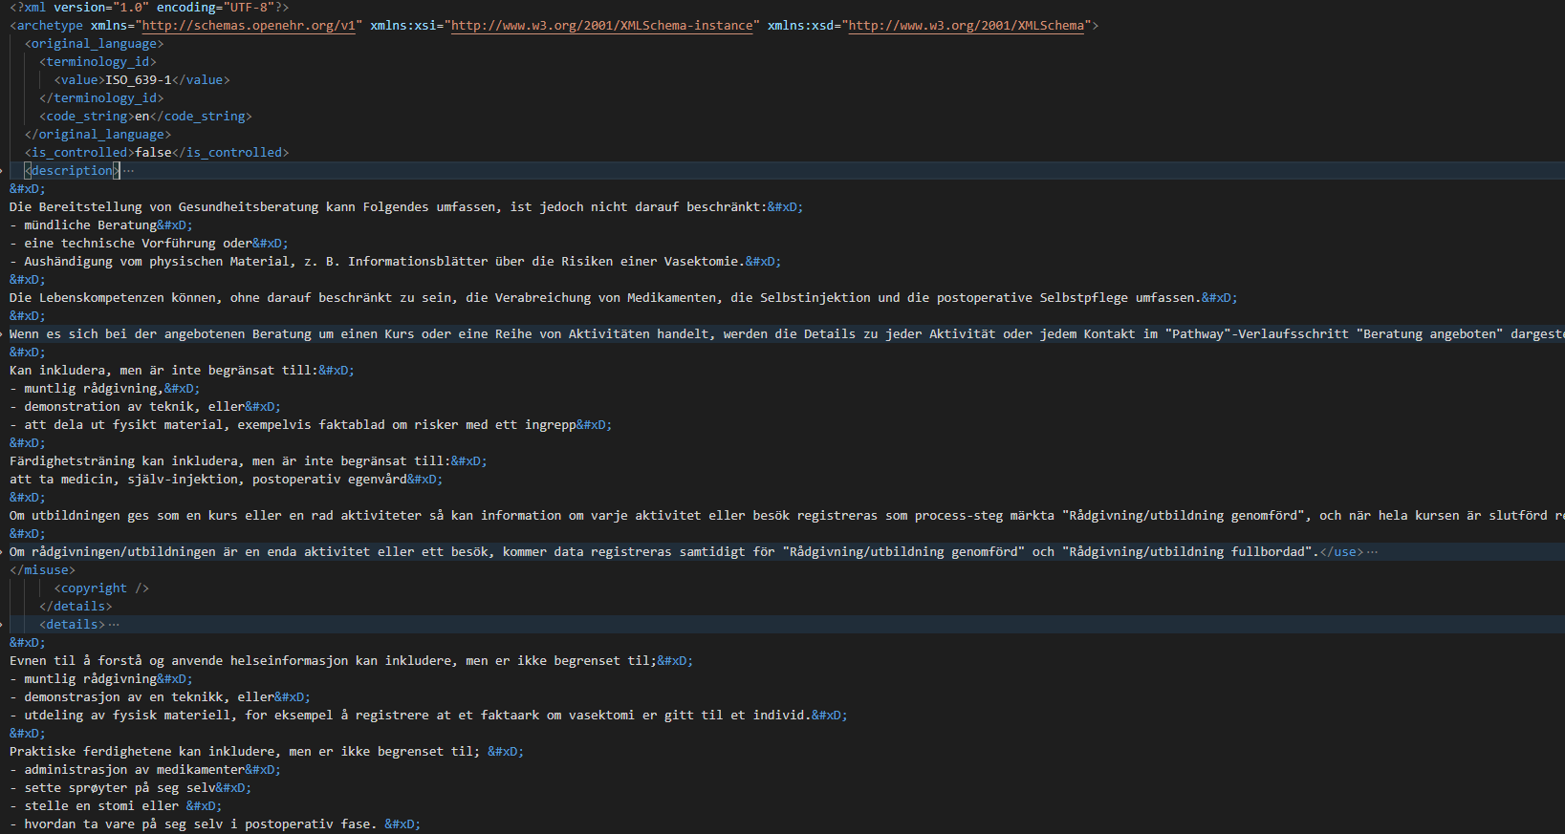
OpenEHR

Slide 8
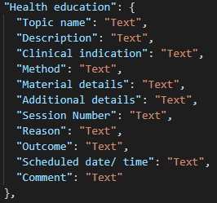
Interesting

Slide 9
Approach
Look for available sources
Problem
Only OpenEHR provides them via bulk exports
The models exported contains many uninteresting properties, and some interesting properties were not included.
Rejected

Slide 10
Approach
Web scraping
Problem
Static website (FHIR) vs Single Page Application (OpenEHR)
Anonymous classname
Duplicate selectors
Invalid format (FHIR, JSON format)
Invalid comments
Invalid object notation
Missing commas

Slide 11
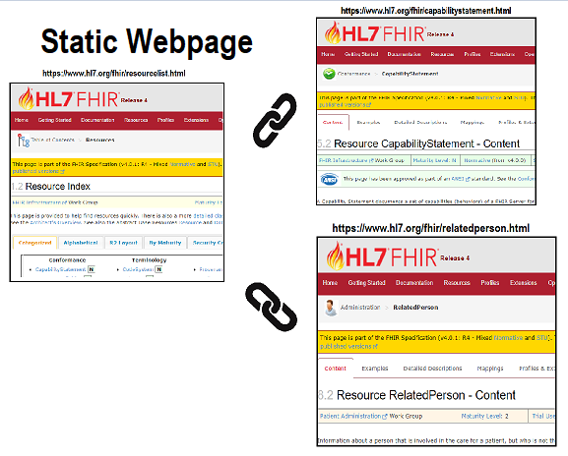
Each link LINKs to an actual DOCUMENT

Slide 12
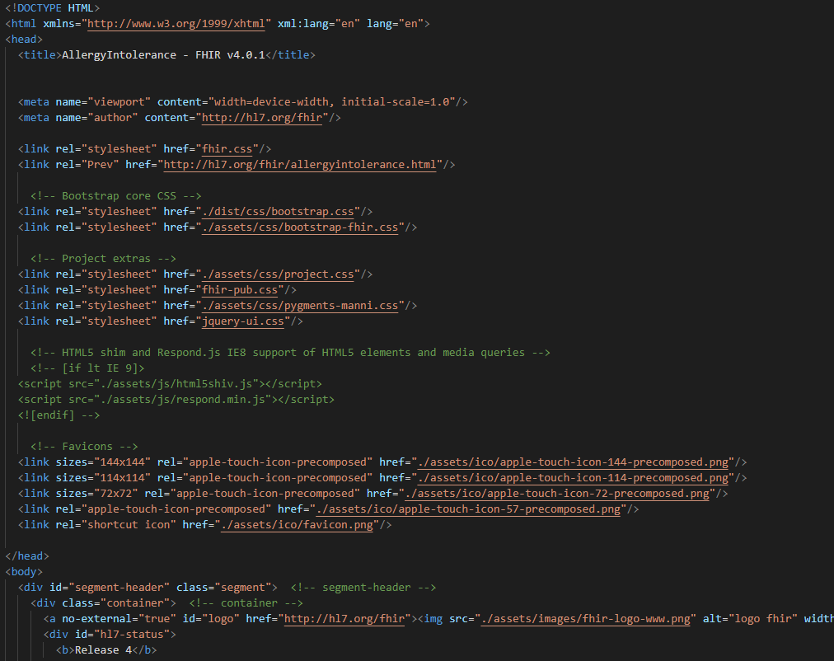
Each link LINKs to an actual DOCUMENT

Slide 13
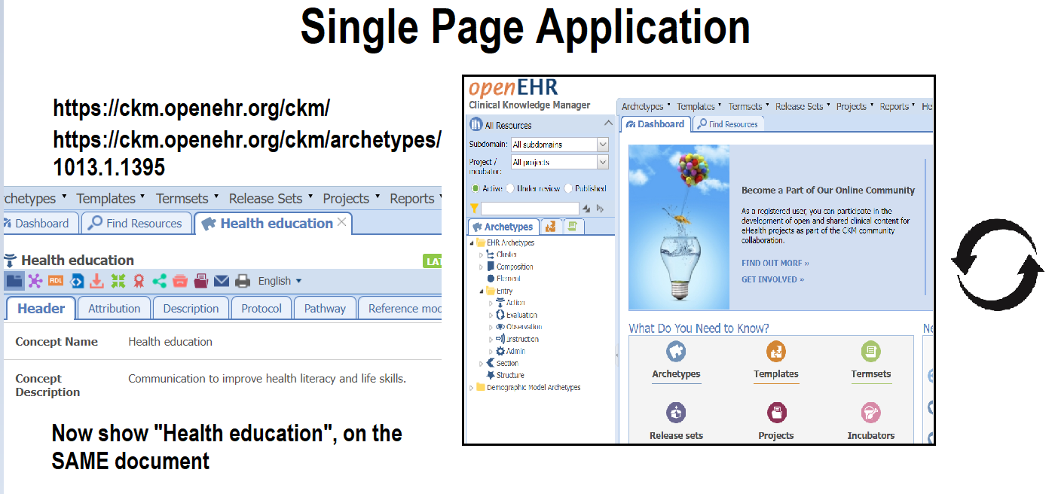

Slide 14
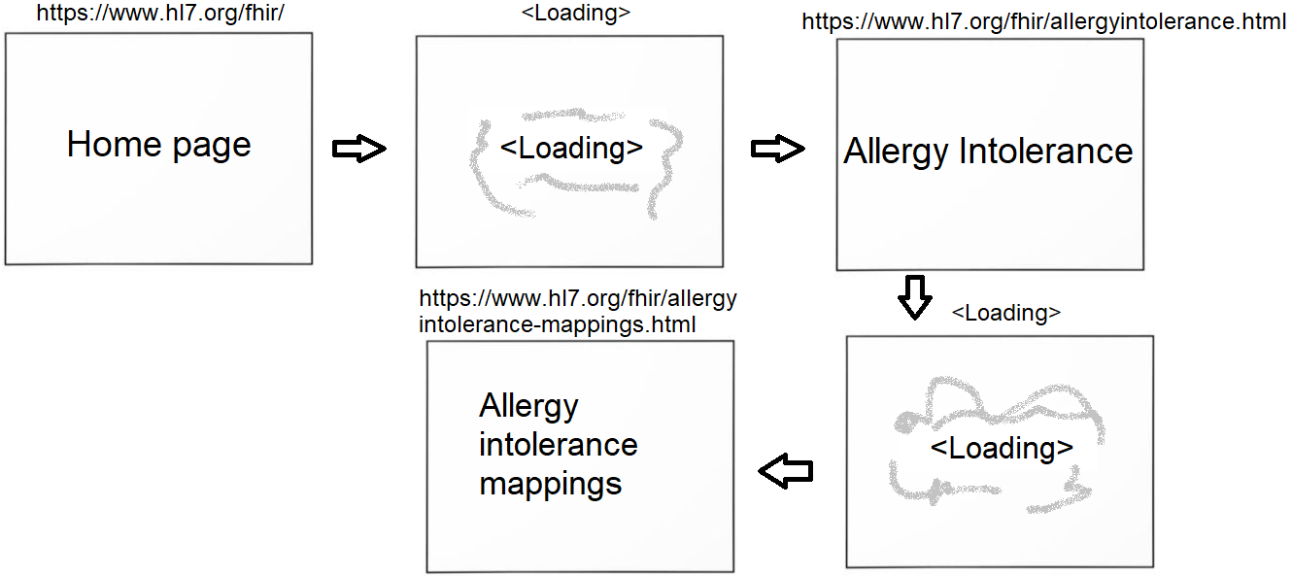
Each link changes the STATE of the document
Think of getting a whiteboard, and then erase and draw on the SAME whiteboard

Slide 15
Invalid format (FHIR, JSON format)
<Image>

Slide 16
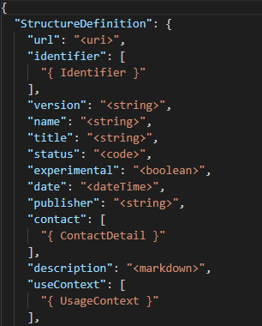
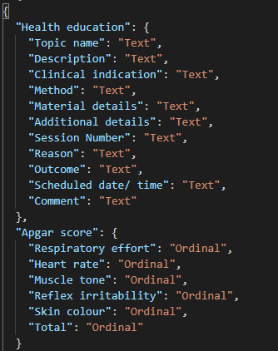
The Models
FHIR
OpenEHR

Slide 17
Challenge
Identifying base types
Identifying complex types

Slide 18
Data Quality Analysis

Slide 19
Data Quality Analysis

Slide 20
Data Quality Analysis

Slide 21
Data Quality Analysis

Slide 22
Data Quality Analysis

Slide 23
Conclusion

Slide 24
Vision for future
Suggestion

Slide 25
references
-
-
-

